Slide 1
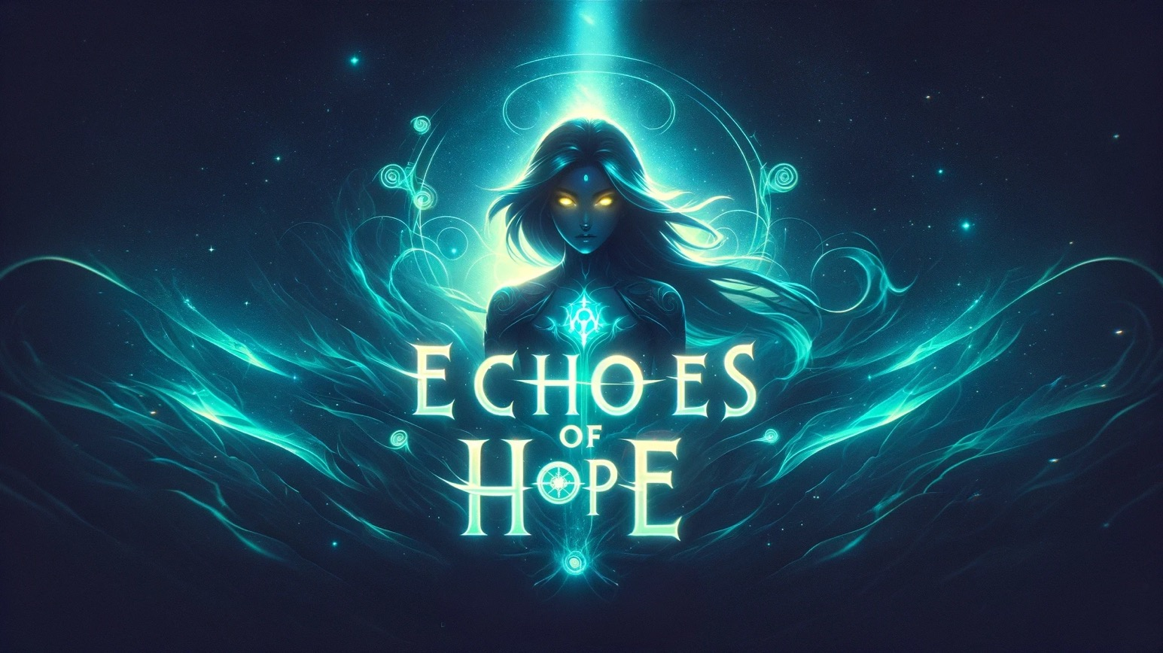

Slide 2
The Fractured Return
The Syndicate’s return to Earth marked a turning point. Scattered across the fractured world, each member carried the power of the Orb, embarking on separate paths to fight for the planet’s future. For Zyra, it was a path she never expected.
She hadn’t sought this power, but now it coursed through her hands, her staff glowing with energy. In a world where people were losing their movement and minds, shadows loomed—Mnemoros and Atroxys, though unseen, left their mark everywhere. Zyra didn’t yet know them, but she could feel their darkness creeping closer.
With no plan but unshakable resolve, Zyra stepped forward, ready to protect those who needed her most. Whatever lay ahead, she was determined to fight back the shadows.

Slide 3
Zyra’s Resolve Part. 1
Zyra stood at the edge of the Ethereal Rift, the turbulent portal crackling with turquoise and gold light. It was a scar in the fabric of reality, dividing her gleaming futuristic city from the foreboding abyss beyond. The storm-like winds whipped at her emerald-green tunic, the energy swirling around her casting a stark contrast against her cobalt-blue skin. Her yellow eyes burned with determination as they fixed on the dark horizon.
The Orb atop her staff pulsed, a rhythmic glow that resonated with her resolve. This was no ordinary artifact—it was alive, its energy coursing through her like a second heartbeat, powered with Xilas. She tightened her grip, the weight of its power both reassuring and daunting. Beyond the portal, the jagged shadows of Mnemoros and Atroxys began to take shape, skeletal figures wrapped in an aura of swirling red and black. She hadn’t yet met them, but the devastation they caused was unmistakable. She had seen it in the broken bodies and hollow stares of the people left in their wake—paralyzed, forgotten, consumed.
Behind her, the city’s skyline shimmered, a distant reminder of what she was leaving behind. Ahead, the jagged landscape of the Rift beckoned her into the unknown. The portal’s glow illuminated her solitude, a stark reflection of her journey. The Syndicate was scattered, fighting battles across the world. For now, she faced this challenge alone.
She stepped closer to the Rift, her breath steady despite the chaos swirling around her. The Orb flared brighter in her hands as if sensing her readiness. Mnemoros and Atroxys loomed like ghosts on the other side, their forms flickering in and out of focus. Though fear crept at the edges of her resolve, it never overtook her.
This wasn’t about proving herself or living up to the Syndicate’s mission. It was about answering the silent cries of those who couldn’t fight back. Zyra didn’t yet know how she would face the malevolent forces waiting beyond the Rift. But with every step forward, she made one thing clear—she would.
The portal pulsed as she crossed its threshold, the swirling energies enveloping her. Zyra didn’t look back.
Notes:
External Link
Description

Slide 4
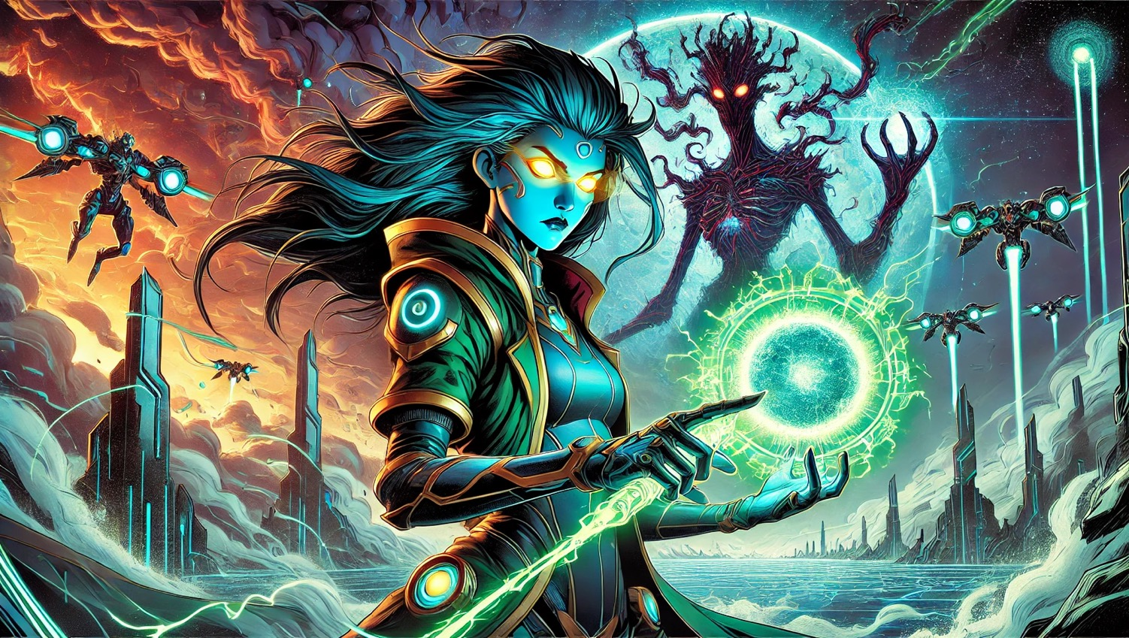

Slide 5
First Strike
The battlefield was chaos—a crumbling expanse of obsidian surrounded by jagged cliffs and a sky fractured by red lightning. Distorted memories floated like specters in the air, echoes of lives erased by Mnemoros.
Zyra faced them, her glowing staff raised defensively. Mnemoros, skeletal and spectral, extended his claws, warping the air with chaotic distortions that made the ground ripple unnaturally. Beside him, Atroxys towered in silence, his dark armor twisting with barbed tendrils, a glowing chain coiled tightly in his hand.
Mnemoros struck first, his claws slashing through reality itself. The battlefield warped and twisted, but Zyra’s shield flared brightly, deflecting the attack. She thrust her staff forward, channeling a brilliant beam of turquoise energy that struck Mnemoros, forcing his shadowy form to recoil.
Atroxys followed, his chain snapping forward like a serpent. It struck her shield with a deafening clash, barbs grinding against her defenses. Sparks flew as Zyra held her ground, the energy of the Lens surging through her. With a fierce cry, she shattered the chain’s grip, sending Atroxys staggering back.
For a moment, the storm above seemed to pause, the battlefield illuminated by the glow of her staff. Though outnumbered, Zyra stood tall, her fearless gaze fixed on the shadowy figures before her. The battle was far from over, but the light she wielded had begun to push back the darkness.

Slide 6
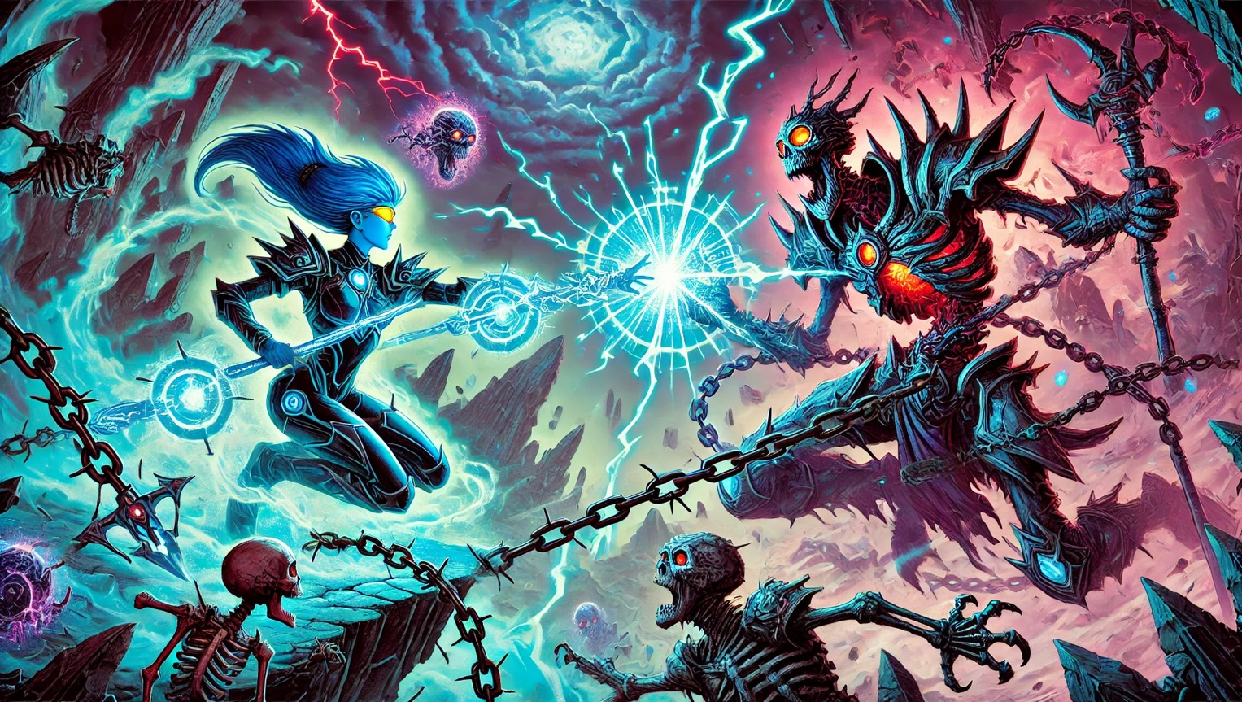
Notes:
Episode 2: The Journey

Slide 7
Triumph of Light?
Zyra staggered, the staff flickering as the combined assault of Mnemoros and Atroxys bore down on her. The obsidian battlefield trembled beneath her feet, cracks radiating outward like veins of impending collapse. The power of the Orb, once radiant, dimmed under the relentless onslaught.
Mnemoros surged forward, his spectral claws distorting the air, while Atroxys’s shattered chains reformed, writhing like serpents eager to strike. Zyra braced herself, her knees threatening to give way as the Lens struggled to keep up with the overwhelming darkness pressing in.
For a moment, it seemed she would fail. Her breaths came in shallow gasps, her vision blurred, and her grip on the staff faltered. The red lightning overhead burned fiercely, as if the storm itself fed on her exhaustion. Yet somewhere deep inside, a flicker of resolve remained.
Her yellow eyes narrowed. The Orb at the tip of her staff pulsed faintly, a heartbeat of energy that refused to fade. As Mnemoros lunged, Zyra let out a fierce cry, raising her staff one last time. The pulse grew brighter, sending a thin shockwave outward. It wasn’t enough to drive them back entirely, but it forced them to hesitate, their attacks faltering.
The cracks beneath her glowed faintly with turquoise light, and the storm above seemed to pause for a brief moment, as if holding its breath. In that moment, Zyra steadied herself, gripping her staff with renewed determination. Her power wasn’t fully unleashed—yet—but something had shifted. A spark of hope, fragile but undeniable, ignited in her.
The storm roared back to life, the darkness pressing in again. But as Zyra stood against it, battered but unyielding, a memory flashed in her mind—a moment from her training aboard the Syndicate’s ship. It was a memory of focus, of discipline, and of what the Lens was truly capable of.
And for the first time, it felt within reach.
Notes:
External Link
Description

Slide 8
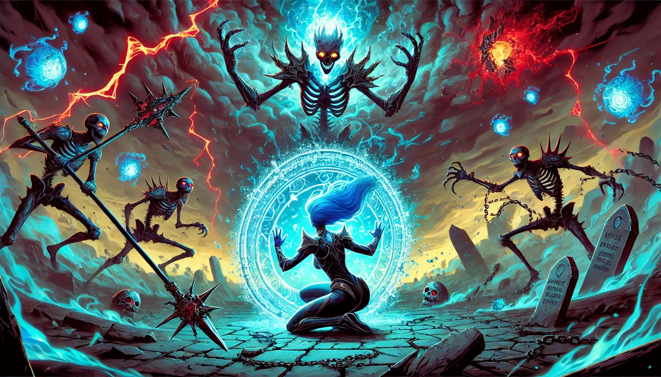
Notes:
Name: First Encounter
We are directed to seek the path through the mountain

Slide 9
Echoes of the Keepers
The Chamber of Echoes shimmered with quiet energy. Zyra stood on a glowing circular platform, surrounded by floating glyphs and beams of light—each holding the memories of past Keepers. The chamber blended ancient and futuristic designs, its metallic pillars etched with glowing inscriptions.
Zyra held her staff cautiously, the turquoise light faint and hesitant. Before her, a spectral figure of a former Keeper emerged, its presence commanding yet calm. It extended its hands toward her. “The Orb of Healing reflects what is within you,” the Keeper said. “Show me your resolve.”
Taking a breath, Zyra stepped forward. The glyphs pulsed brighter, their energy circling her like threads of light. Her staff hummed softly, its glow syncing with the rhythm of the chamber. Doubts flickered in her mind—images of a broken Earth and the suffering she would face—but she pushed them aside, focusing on a single thought: I must help them.
The turquoise light flared suddenly, the beams of energy weaving into a radiant web around her. The Keeper’s voice softened. “You begin to see. But strength alone will not save the world. It is what you choose to do with it that matters.”
As the light dimmed, Zyra opened her eyes, feeling a faint but unmistakable connection to the Orb. She wasn’t ready yet—but she was closer.
Notes:
External Link
Description

Slide 10
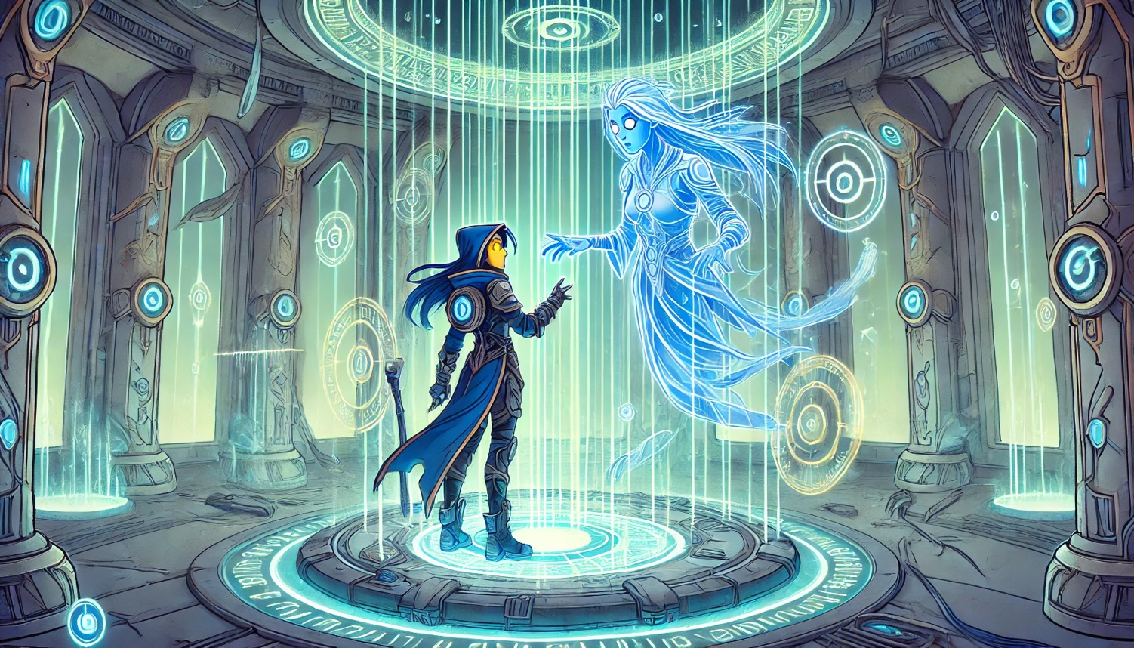
Notes:
Name: Go Deeper

Slide 11
Zyra’s Resolve Part 2
Zyra forced herself to stand, the weight of exhaustion pressing down on her. Her shield had shattered, leaving her vulnerable, but she wasn’t finished. The Orb pulsed in her hands, a faint glow that refused to die. Taking a steady breath, she raised her staff, and the turquoise energy reignited, stronger than before.
The shattered fragments of her shield reformed, blazing into an unbreakable barrier of light. With a cry of defiance, she drove the staff into the cracked obsidian ground, unleashing a shockwave that rippled outward. Atroxys stumbled, his massive frame struggling to hold steady, while Mnemoros’s spectral form flickered wildly, his claws retreating into shadow. The villains staggered, their dark auras wavering under the surge of her power.
The battlefield erupted with turquoise energy, the cracks in the ground glowing like veins of light. The red lightning in the sky dimmed, fading as Zyra’s light overwhelmed the storm. Her staff burned with overwhelming power, the ground beneath her trembling as her strength grew.
Mnemoros hissed, his spectral form beginning to dissipate into a haze of shadows. Atroxys’s barbed chains fell limp at his sides, their sinister glow extinguished. For the first time, the darkness faltered, and Zyra’s unyielding determination shone through. Her fierce, resolute expression left no doubt—she would not back down.
As the villains hesitated, struggling to regroup, Zyra took her stance once more, ready to press the attack. The balance of the battle had shifted, and her light was winning.
Notes:
External Link
Description

Slide 12
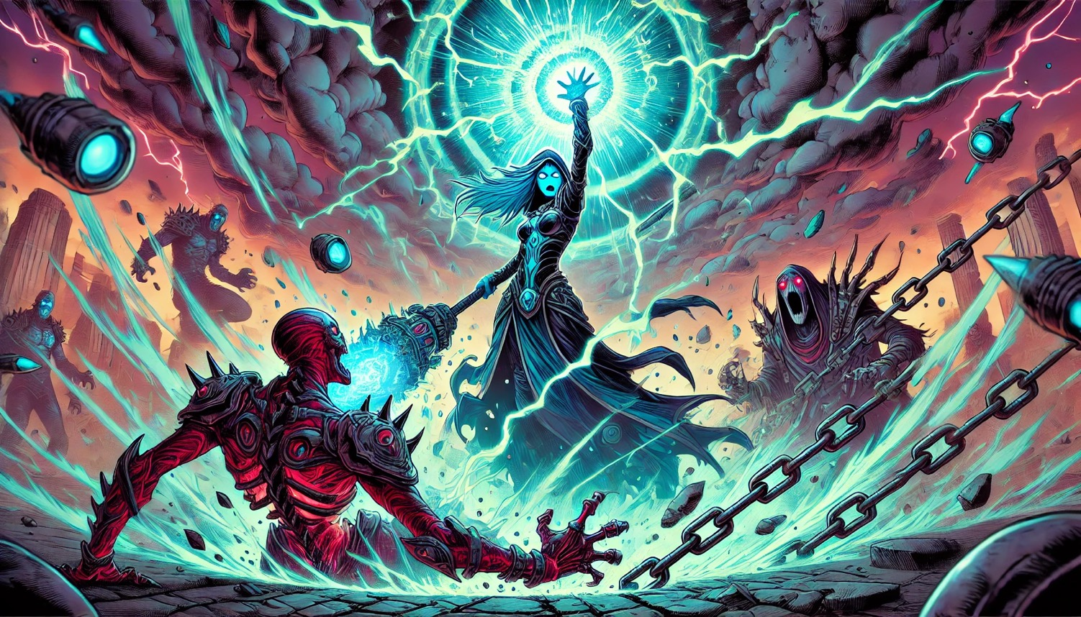
Notes:
Name: Go Deeper

Slide 13
A Fractured Victory
The battlefield lay in ruin, cracks glowing faintly with the remnants of Zyra’s energy. The obsidian ground trembled as Mnemoros and Atroxys faltered, their forms weakened and unstable. Atroxys’s barbed chain slithered back to him, glowing faintly with malevolent energy. With a roar of frustration, he hurled it into the air, creating a towering barrier of dark energy that pulsed like a living wall.
Mnemoros’s spectral form flickered violently, twisting into a distorted vortex of shadows. His hollow gaze lingered on Zyra for a moment before he hissed and vanished into the void. Atroxys followed, his massive frame retreating into the safety of the barrier as the battlefield grew silent.
Zyra stood firm, her glowing staff held high, though her shoulders sagged under the weight of exhaustion. Her breath was heavy, her legs unsteady, but she refused to waver. The turquoise light of the Orb still pulsed faintly, a beacon in the scarred and chaotic landscape.
Above, the storm began to dissipate, the red lightning fading into the clouds. Yet faint red tendrils lingered in the sky, a reminder of Mnemoros’s power and the battle still to come. Zyra stared into the horizon, knowing this was only a temporary victory. The darkness hadn’t been defeated—only delayed.
Though unable to pursue, Zyra’s resolve remained. The fight wasn’t over, and the world still needed her.
Notes:
External Link
Description

Slide 14
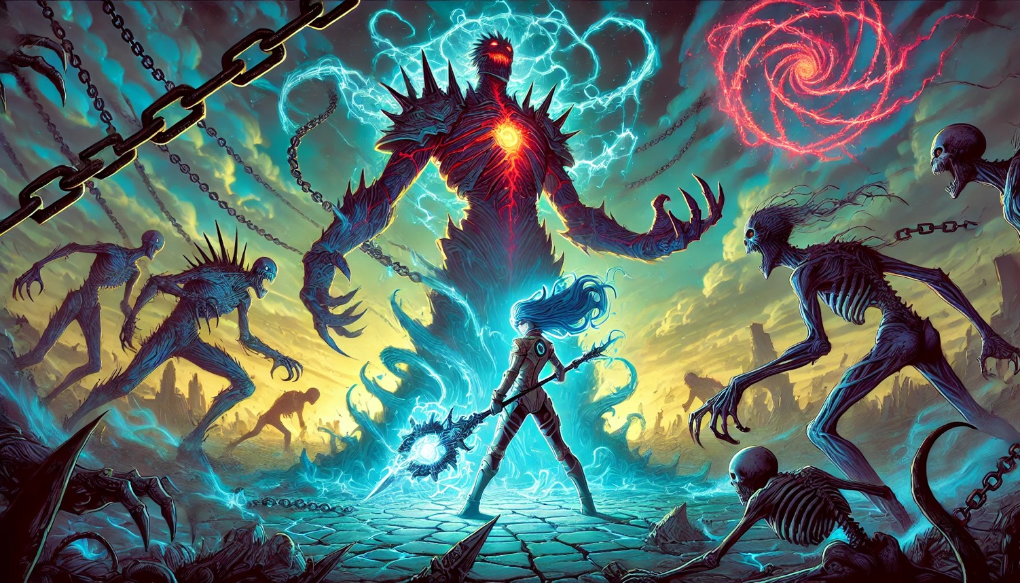
Notes:
Name: Go Deeper

Slide 15
Wounds of Earth
Zyra knelt on the fractured obsidian ground, her long cobalt-blue hair cascading over her shoulders. The glowing staff in her hands pulsed softly, emitting waves of turquoise energy that spread outward like ripples in a still pond. Each pulse touched the shattered remnants of the battlefield, bringing light and life where there had been only ruin.
Around her, injured civilians began to stir. Cuts closed, bruises faded, and faint turquoise glows lingered on their skin as her energy worked to heal them. Even the scarred earth softened, cracks mending as flowers and faint grasses began to emerge amidst the wreckage.
The stormy sky above slowly cleared, the oppressive red clouds retreating to reveal patches of soft sunlight breaking through. The warmth of the light mingled with the glow of her energy, creating a sense of fragile renewal.
Zyra’s shoulders slumped, her exhaustion evident in the way she leaned on her staff for support. Yet her resolve remained unshaken, her golden eyes glowing faintly as she focused on the lives she could save. This moment wasn’t about her battle—it was about the people who had suffered and needed her strength.
As the land would slowly regenerate, so too would glimmer of hope. For the first time, the battlefield didn’t feel like a place of despair. It felt like a place where something new could grow.
Notes:
External Link
Description

Slide 16
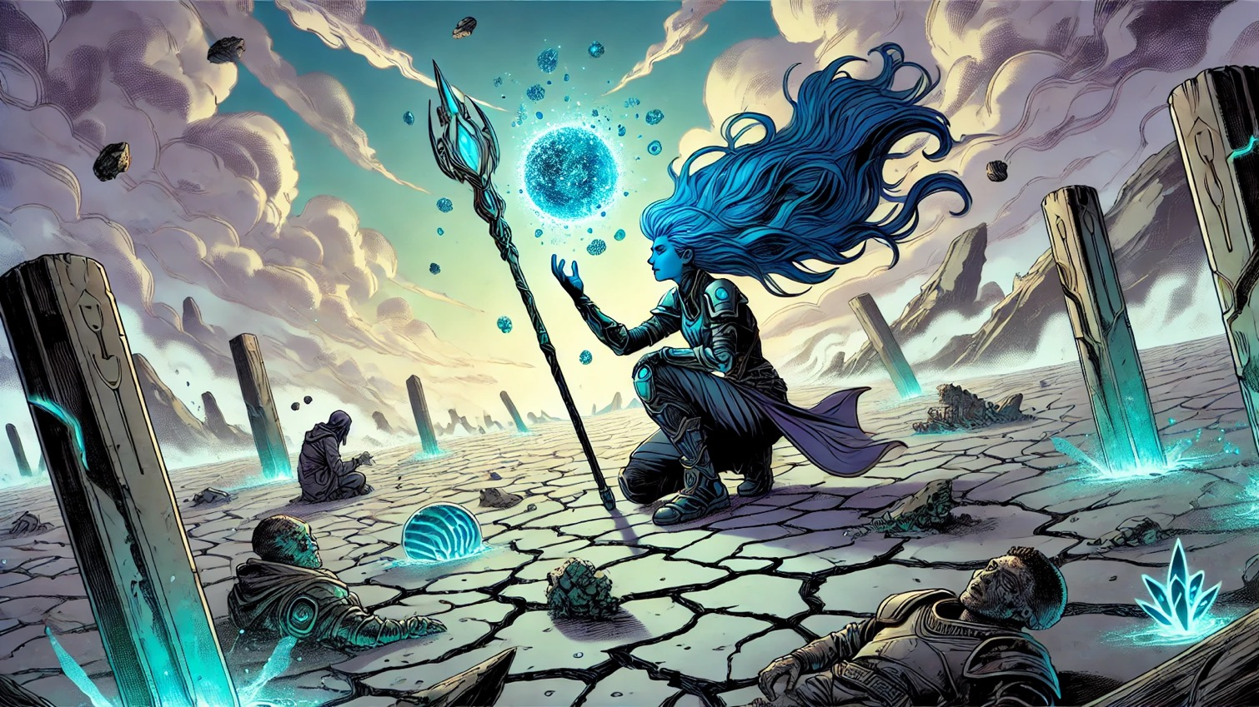
Notes:
Name: Go Deeper

Slide 17
A Beacon of Hope
Zyra sat on a rocky outcrop, her cobalt-blue hair flowing softly in the breeze. The battlefield stretched out before her, transformed from ruin into a place of fragile renewal. Survivors moved in the distance, their figures glowing faintly with the Orb’s energy she had imbued into the land. They worked to rebuild, their movements steady and hopeful, signs of a future beginning to take shape.
Her staff rested by her side, mirroring the clearing sky. The last traces of the storm dissolved, replaced by warm sunlight breaking through the clouds. Zyra’s golden eyes scanned the horizon, her expression thoughtful but resolute. Behind her, a small group of civilians and allies watched silently, their admiration and growing trust palpable.
She let her gaze linger on the horizon, thinking of the battles to come. Mnemoros and Atroxys weren’t defeated, only driven back. Their power still loomed in the shadows, waiting to strike again. Zyra knew she couldn’t face them alone—not forever. But the flicker of hope she had ignited today was enough to strengthen her resolve.
The Syndicate would come back together. They would find their way to one another, their shared mission uniting them once more. The journey ahead would be long, filled with struggles and sacrifices, but Zyra believed in the strength they had forged across the stars. Together, with the power of the Lens and the will of those who joined their cause, they would win the war.
For now, Zyra let herself breathe, the Orb of Healing reflecting in her steady gaze. The battles would continue, but so would her fight. Bit by bit, she was proving that the darkness could be pushed back—and that together, they could reclaim the future.
Notes:
External Link
Description

Slide 18
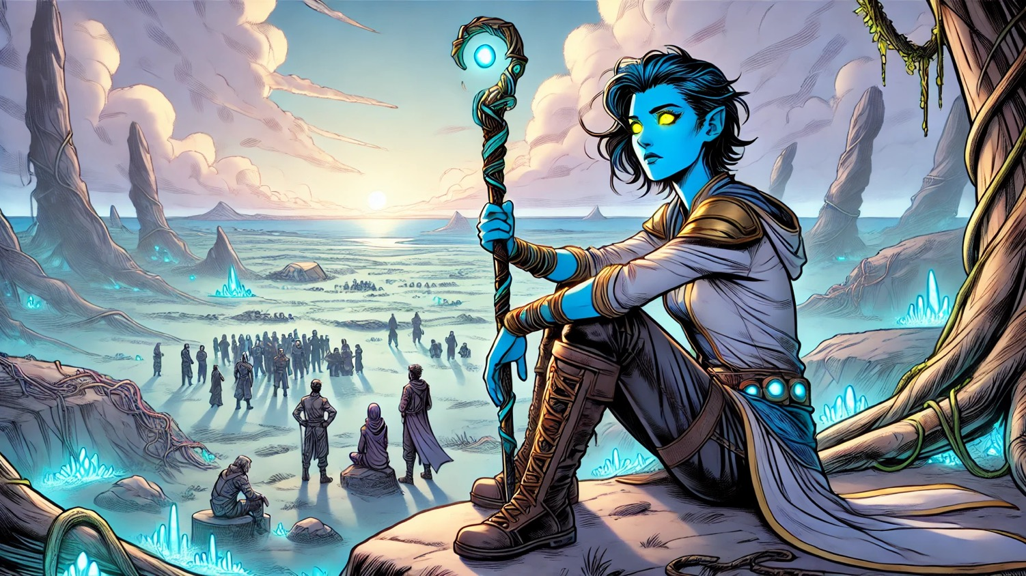
Notes:
Name: Second Encounter - The Gift
She is pleased. Grants u

Slide 19
Join us to help write what happens next.

Slide 20
Thank You

